Slide 1
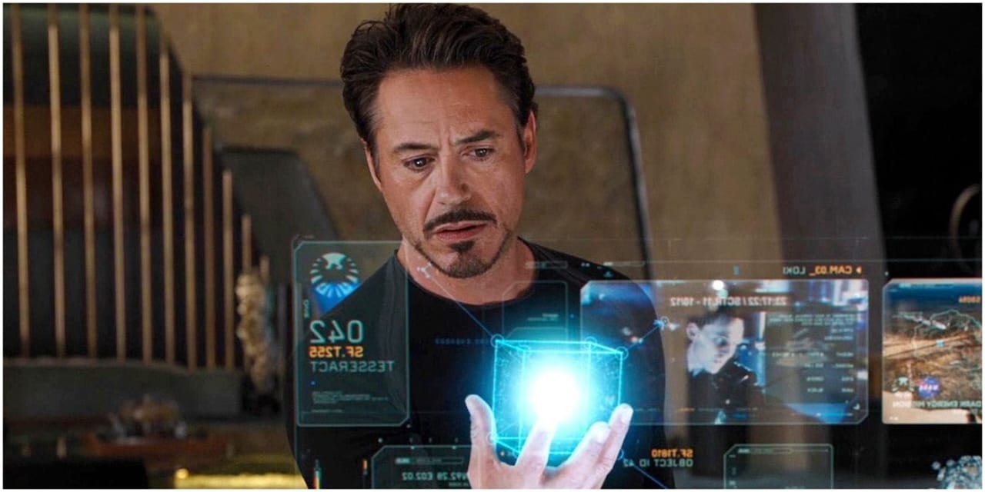
Augmented Reality (AR)
AR GROUP
Group members
PAWAN SUBEDI
AAYUSH ADHIKARI
PRAYATNA BHANDARI

Slide 2
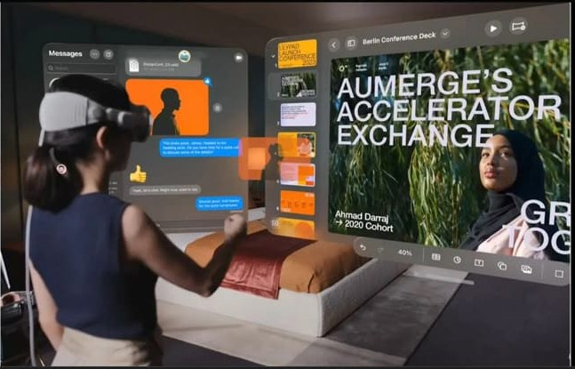
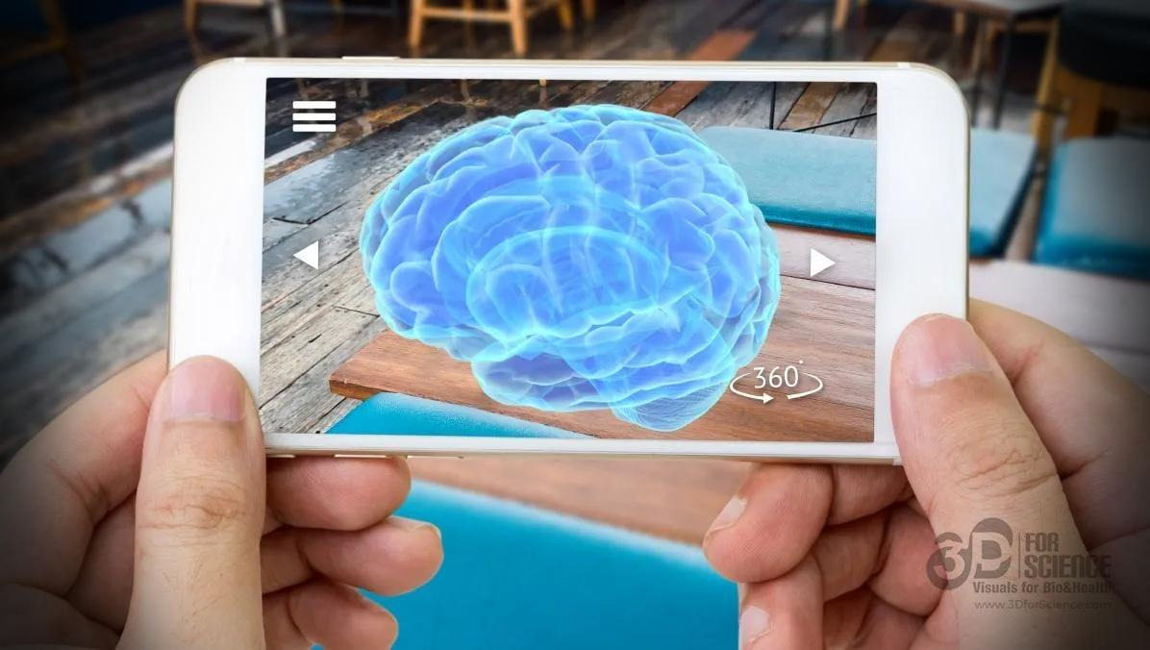
Abstract
Augmented Reality (AR) is a transformative technology that blends digital content with the real world, enhancing the user’s perception and interaction with their environment. This presentation discusses the core concepts of AR, its current applications, the challenges faced in its adoption, the opportunities it presents across various sectors, and potential future developments. By analyzing research findings and real-world case studies, we explore how AR is reshaping industries like healthcare, retail, and education.

Slide 3

Introduction
What is Augmented Reality?
Augmented Reality (AR) is a technology that overlays digital objects, such as images, videos, or data, onto the physical world. This is done in real time using devices like smartphones, tablets, and AR glasses.
Distinction from Virtual Reality (VR):
AR enhances the real world with virtual elements.
VR immerses users in a completely artificial environment, disconnecting them from the real world.
Historical Development:
AR has evolved from military applications in the 1960s to the current widespread use in gaming, healthcare, education, and retail.

Slide 4
Problem Statement
Integration and Compatibility Issues:
Despite its potential, AR often faces difficulties in seamless integration with existing digital ecosystems. Many AR applications operate as isolated systems, limiting their cross-industry applicability and scalability.
Technological Barriers:
AR requires sophisticated hardware and software for tracking, sensing, and rendering digital content in real-time. Current devices like AR glasses or headsets still face limitations in processing power, battery life, and display quality.
Usability and Comfort Concerns:
Current AR headsets are bulky and uncomfortable for extended use. They are also expensive, preventing mass adoption. Additionally, AR apps require high levels of accuracy in object recognition and environmental mapping, which can be difficult to achieve in diverse real-world conditions.

Slide 5
Research and finding
Technological Advancements in AR:
Recent studies show significant improvements in AR hardware, such as lighter, more efficient AR glasses, and advanced computer vision algorithms that enable better interaction with real-world objects.
AR in Healthcare:
Research highlights AR’s potential to assist in medical procedures, such as real-time visualization during surgery, enabling more precise operations. Furthermore, AR is used in medical training by simulating complex surgeries and procedures.
AR in Education:
AR has demonstrated its ability to transform the learning experience. Studies show that students who engage with AR-based learning tools perform better in subjects requiring visual understanding, such as anatomy, engineering, and design.
AR in Retail and Marketing:
Market research indicates that AR increases consumer engagement by allowing virtual try-ons, interactive ads, and immersive shopping experiences. Brands have reported higher customer satisfaction and conversion rates.

Slide 6
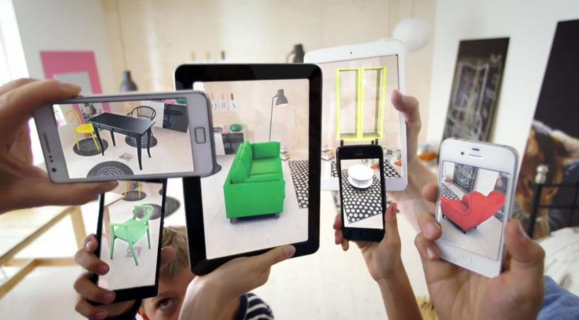
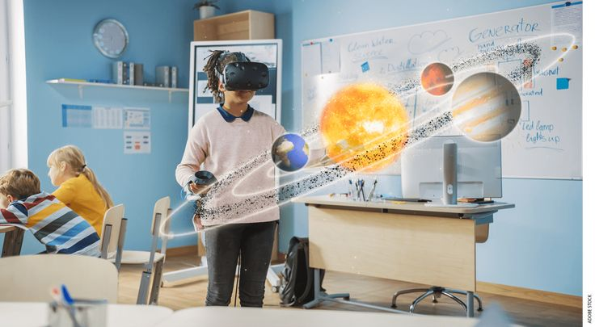
Opportunity
Revolutionizing Retail:
AR allows consumers to visualize products in real time before making purchasing decisions. Virtual try-ons for clothes, makeup, and even home furniture are gaining popularity and enhancing customer satisfaction.
Transforming Education and Training:
AR can create interactive, hands-on learning experiences that engage students. In fields like medicine and engineering, AR can provide realistic simulations that allow learners to practice without the risk of real-world consequences.
Enhancing Healthcare:
AR’s potential in healthcare is immense. Surgeons can use AR to see 3D visualizations of patients' organs, while remote medical experts can assist in procedures using AR to guide on-site personnel.
Remote Assistance and Collaboration:
AR allows experts to provide real-time support and guidance remotely. Whether for troubleshooting technical issues, guiding assembly tasks, or teaching new skills, AR improves collaboration by overlaying instructions and annotations in the user’s view

Slide 7
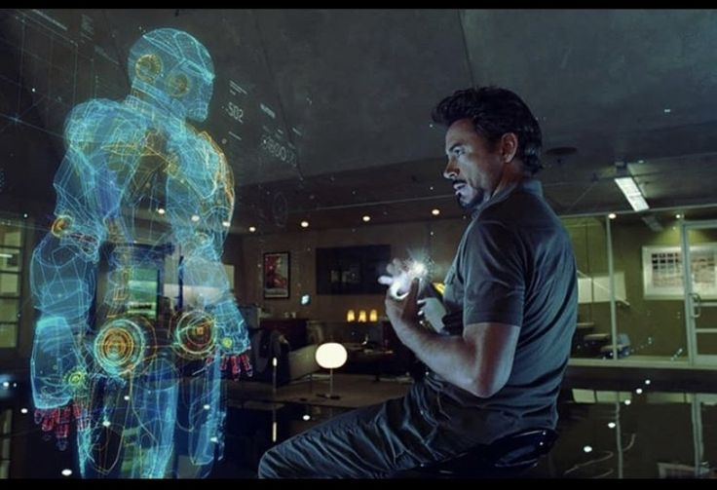
Challenge
Technological Limitations:
AR systems need powerful hardware and software to function seamlessly, which is still a barrier in achieving high-quality, low-latency experiences.
Object recognition and environmental mapping in dynamic real-world settings pose additional challenges to accurate AR experiences.
Cost of AR Devices and Content Development:
The cost of AR devices remains high, and the development of AR content is complex, requiring skilled developers, which increases the cost for businesses and consumers alike.
Privacy and Data Security Concerns:
AR applications often require access to personal data, such as location, environment scanning, and even facial recognition. This raises concerns about user privacy and data security, particularly with the increasing use of AR in public spaces.
User Comfort and Adoption Barriers:
Wearing AR glasses or headsets for extended periods can cause discomfort, including eye strain, dizziness, or headaches. This may deter widespread consumer adoption of AR devices.

Slide 8
Conclusion
Augmented Reality is a transformative technology with the potential to impact a wide range of industries, from healthcare to retail to education.
While there are several challenges related to technology, cost, and user experience, the continuous evolution of AR hardware and software is expected to address many of these issues in the coming years.
The future of AR is promising, with applications likely to expand and become more integrated into everyday life. As the technology matures, AR will offer new opportunities for enhancing communication, learning, and interactive experiences.

Slide 9
References
Include a list of the academic papers, articles, websites, and other sources used to research the presentation. For example:
A systematic review of augmented reality in science, technology, engineering and mathematics education
A framework for analysis and development of augmented reality applications in science and engineering teaching

Slide 10
ANY QUESTIONS ??
THE END...

